Slide 1
determine overall shape from objectshape

Slide 2
I still have not finished determine overall object shape. For now, I will show you what I have done so far.

Slide 3
determine overall object shape from generated objectshape image.py
Before running this python file, make sure you ran the following python files:
Finding shapes.py --- this creates “filename + shapes.txt“
drag_on_image to create object shape3.py --- this creates “"shapes/objectshape/ + filename + matched shape ids.txt“
create objectshape from matched shape ids.py --- this creates "shapes/objectshape/" + filename + ' shape.png'

Slide 4
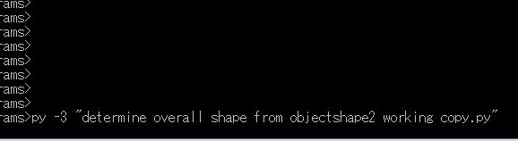
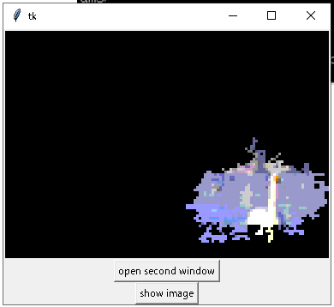
Executing it. Here I changed the name a bit.
Executing it will bring up the objectshapes that I have created
with mouse circled python module.

Slide 5
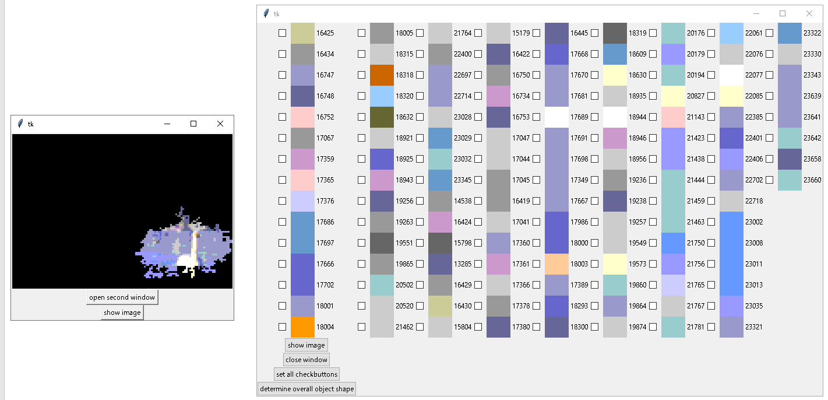
Clicking the open second window brings up the window with all individual shapes of the object shape.
Each individual shape has checkbutton, the appearance of its individual shape, and its id number

Slide 6
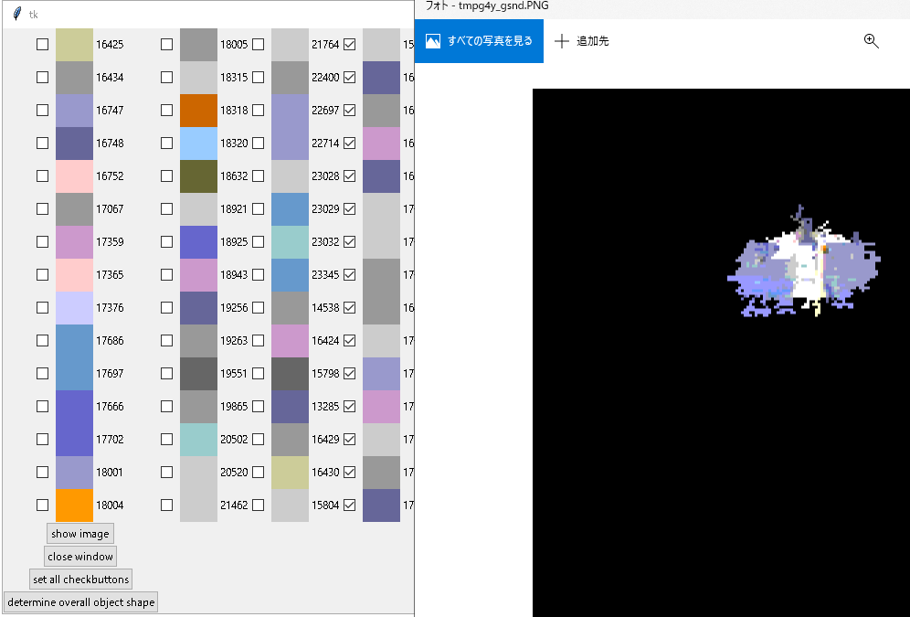
Here, I put checks in some checkbuttons and hit show image button. Then it brought up the image with chosen individual shapes painted with white.

Slide 7
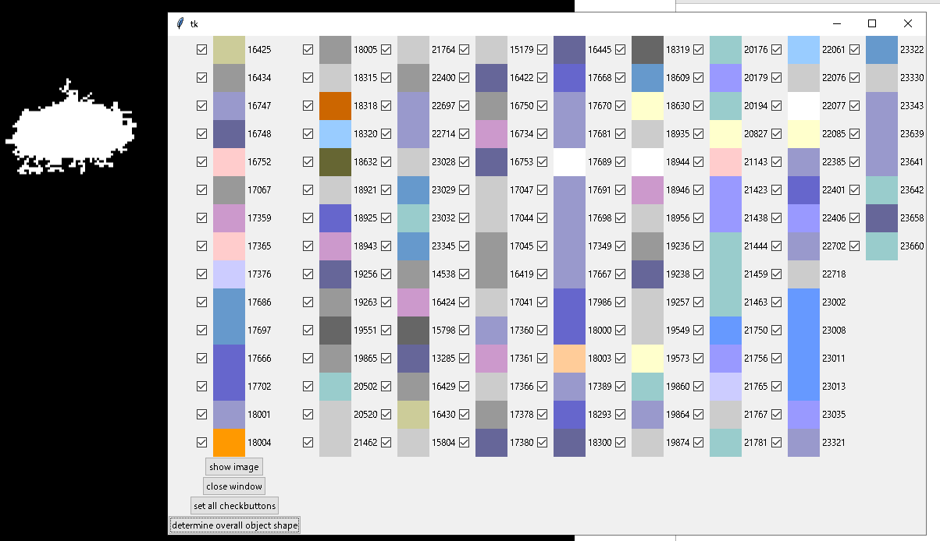
Here, I hit set all checkbuttons button and press show image. It brought up the image you see here.

Slide 8
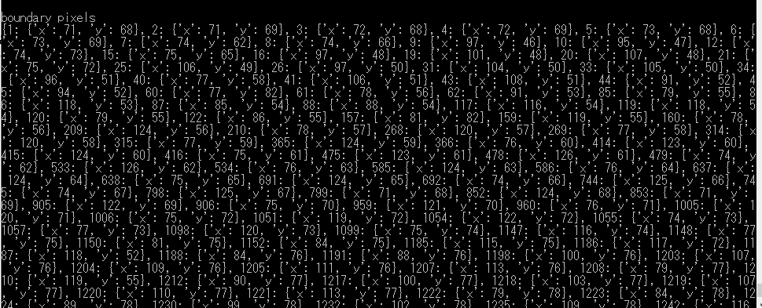
If I hit determine overall object shape, at the moment, it gets all boundary pixels of the chosen shapes. At this point, I made it to output boundary pixels and its chosen shapes to the screen

Slide 9
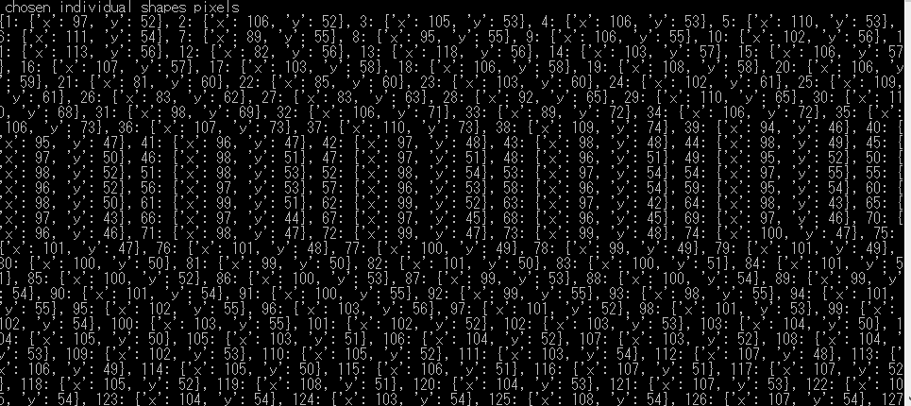

Slide 10
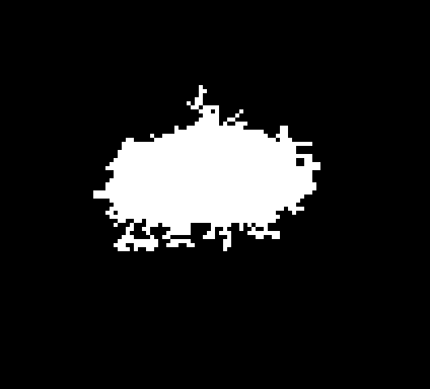
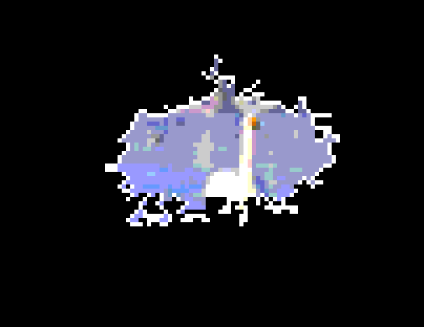
This is what chosen shapes and boundary pixels look like.

